Slide 1
Singapore’s bid to host the
Asia Pacific Federation of Coloproctology Congress 2023 (APFCP 2023 )

Slide 2
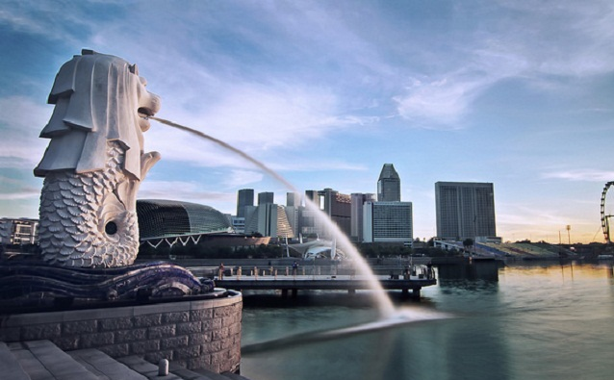
Why Singapore?
Experienced local host –
  Congress of Asian Federation of Coloproctology 2005
  3rd Biennial Congress of Eurasian Colorectal Technology Association 2013
  Biennial Congress of ASEAN Society of Colorectal Surgeons 2014
Leading business events hub – Assurance of a quality meeting experience, with state-of-the-art venues
Safe & politically stable city in the heart of Asia – Reach ~4 billion people within a 7-hour flight
Multicultural city – English-speaking and a neutral ground for international meetings

Slide 3
Society of Colorectal Surgeons Singapore
The Society of Colorectal Surgeons Singapore (SCRS) has been a member of the APFCP since its inception in 2003
The society’s mission is to develop the specialty of colorectal surgery and promote its awareness to a high standard and good standing in Singapore
Active and supportive participant at all previous APFCP activities
Organized the 10th Congress of the APFCP in 2005
It will be our honour to bring international thought-leadership back to Singapore and for us to contribute to APFCP almost 20 years later
Proposed Dates:
Mid-August 2023

Slide 4

Society of Colorectal Surgeons Singapore
Currently we have
  79 full members
  33 associate members
Colorectal surgeons in all acute-care government-funded (6) and private hospitals (7)
Laparoscopic surgery in all hospitals
Robotic surgery in 4 government-funded and 2 private hospitals
Anorectal ultrasound and physiology laboratory in 4 government and 2 private hospitals

Slide 5
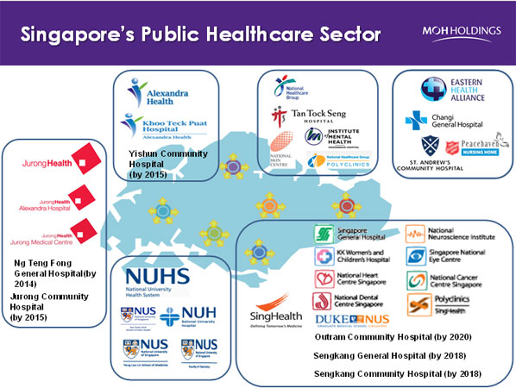
Society of Colorectal Surgeons Singapore
SCRS organizes a biennial national meeting (Singapore Colorectal Week)
Next meeting is 16-18 August 2019
We have the experience and expertise to conduct workshops in:
  Cadaveric settings at 2 hospitals
  Animal laboratories at 3 locations
We have experience and expertise in Live Surgery Sessions
We conducted the first Asian Anorectal Ultrasound Workshop in 2013

Slide 6
Proposed Programme
Broad-based comprehensive colorectal surgery program with focus on evolving knowledge and technology
  Surgical Instrumentation
  Surgical Techniques
  Pelvic Floor Dysfunction
  Cancer Genetics
Comprehensive Nursing track
  Peri-operative Care
  Stoma and Complex Wound Care
Forum on New Technology in Surgical Practice – collaboration with participants of MedTech Forum Asia Pacific and SG Innovate

Slide 7
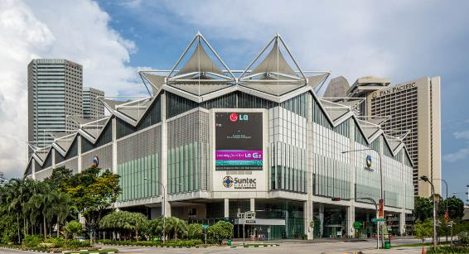
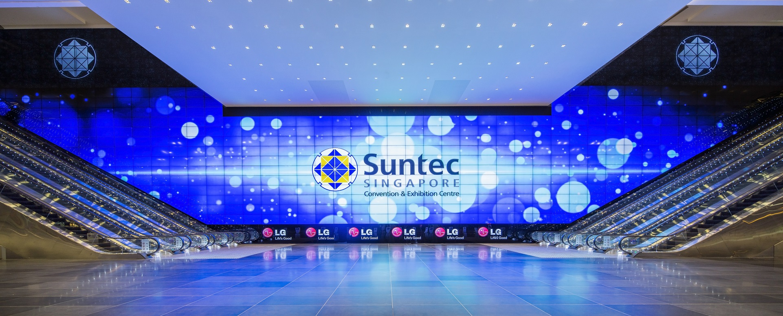
Proposed Congress Venue
Suntec Singapore Convention and Exhibition Centre
Located in the city centre, only 20 minutes from Changi Airport
42,000 sqm of flexible customisable space to cater to the requirements of WCE 2022
Venue-wide, free high-speed WiFi that supports up to 8,000 devices at once
Direct access to 6 hotels, over 1,000 shops, 300 restaurants and various attractions

Slide 8
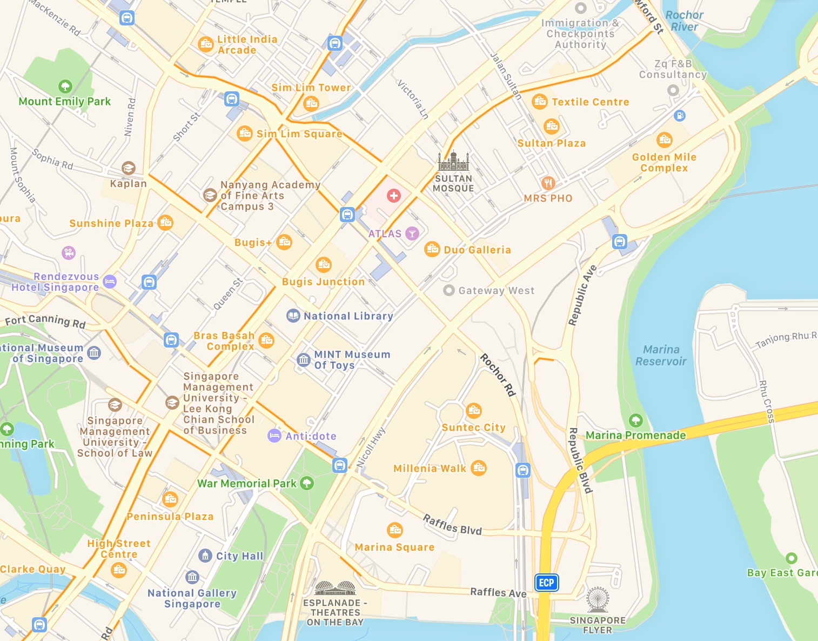

Accommodation Options
A range of accommodation to suit all budgets within the city centre
14
5 Stars (5-10min from Suntec Singapore)
JW Marriott Hotel Singapore South Beach
Conrad Centennial Singapore
Pan Pacific Singapore
The Ritz Carlton, Millenia Singapore
Mandarin Oriental Singapore
Marina Mandarin Singapore
Fairmont Singapore & Swissotel The Stamford
Grand Park City Hall
3-4 Stars (10-15min from Suntec Singapore)
Carlton Hotel Singapore
V Hotel Bencoolen
Hotel Mi
Ibis Singapore on Bencoolen
Mercure Singapore Bugis
Hotel Boss
12
11
13
10
9
1
7
2
8
6
3
5
4

Slide 9

Be assured of a quality meeting experience in Singapore
Top International Meeting City for 10 years
By Union of International Associations (UIA) Ranking 2016
Asia-Pacific’s Top Convention City for 16 consecutive years
By International Congress and Convention Association (ICCA) Ranking 2017
Best Business Traveller MICE City & Best Business City
By TTG Travel Awards 2016 and Business Traveller Asia Pacific Awards 2016
World’s Best Country to do Business
By The Economist, Business Environment Ranking 2014 - 2018

Slide 10
Enriching experiences for delegates

Slide 11
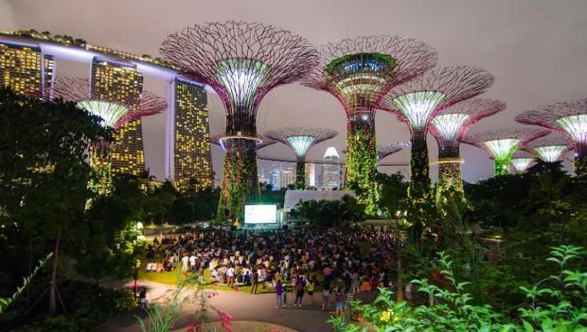
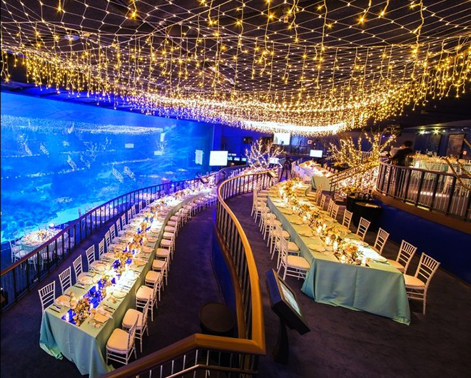
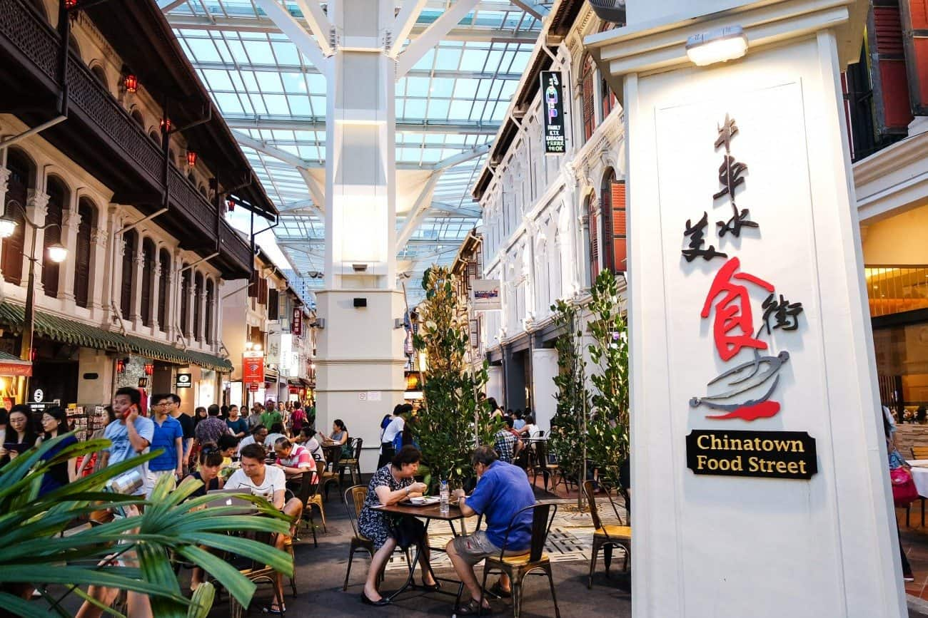
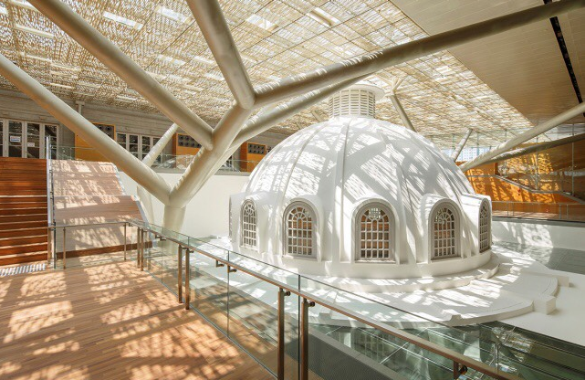
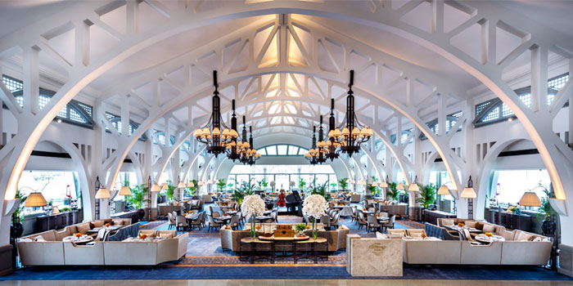
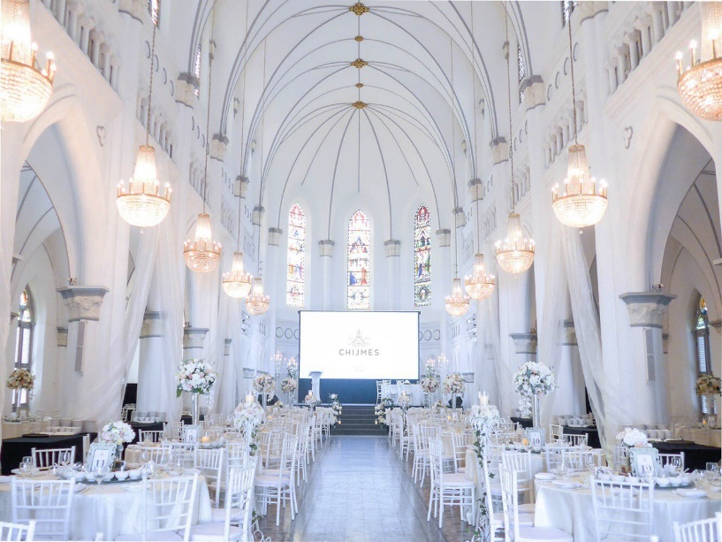
Inspiring and unconventional venues for social networking and exchanges
THE MEADOW AT GARDENS BY THE BAY
RWS SEA AQUARIUM
CHINATOWN FOOD STREET
NATIONAL GALLERY
CLIFFORD PIER
CHIJMES

Slide 12
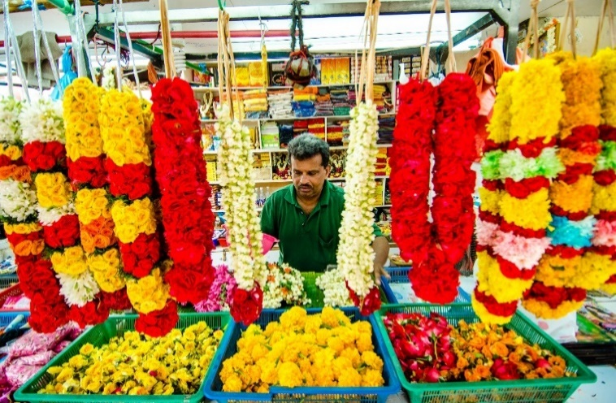
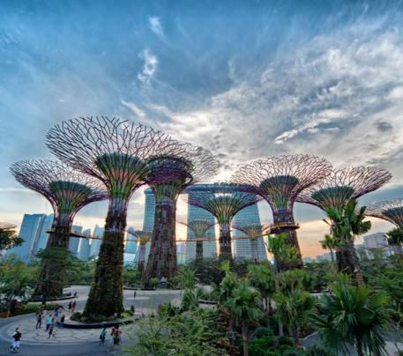
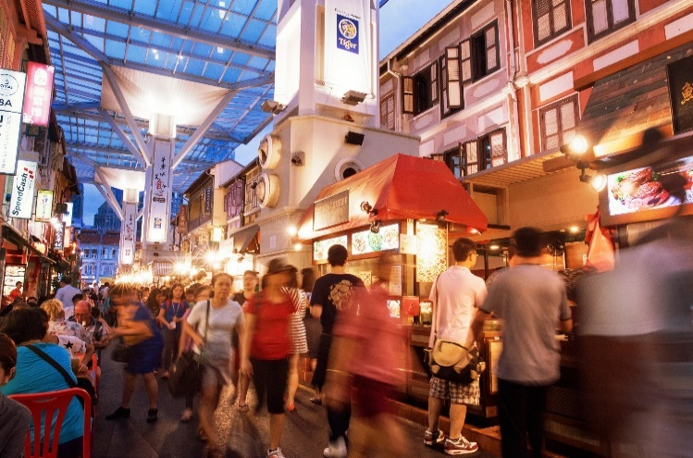
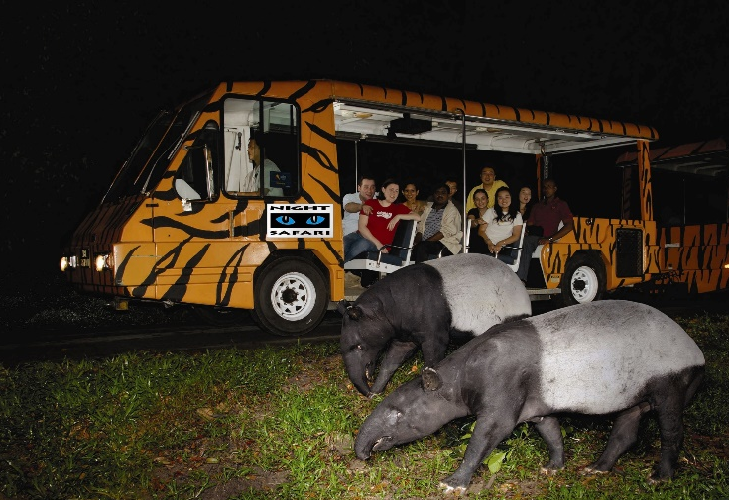
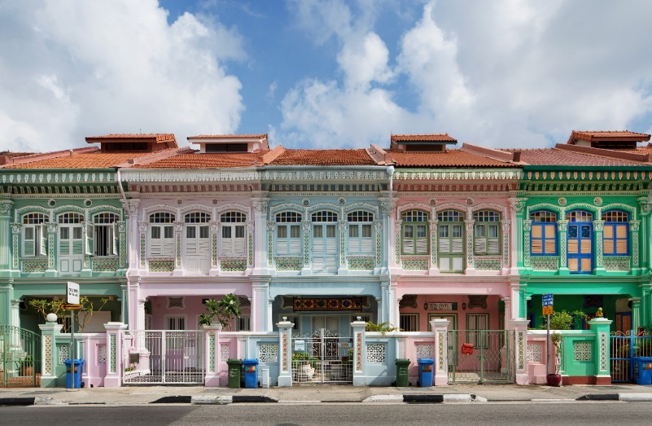
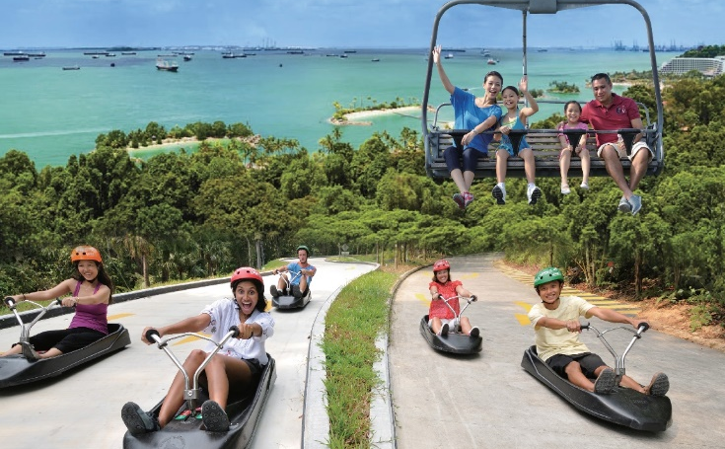
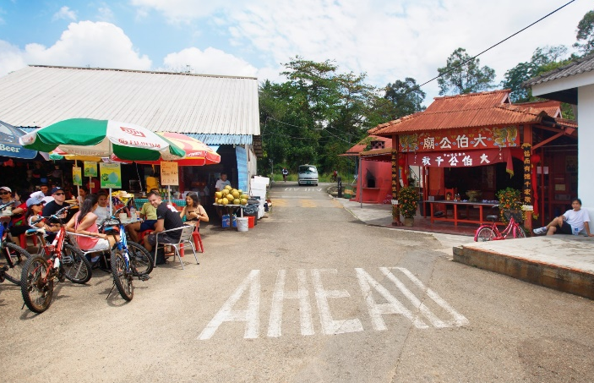
Myriad of local experiences to explore
Weave a flower garland in Little India
Stroll under the SuperTrees
Tuck in to an array of local dishes
Hop on a tram at the Night Safari
Soak in the culture of the Peranakans
Enjoy a day of fun at Sentosa
World’s Cheapest Michelin Meal
Get off the beaten track at Pulau Ubin

Slide 13
Singapore welcomes APFCP 2023!

